Slide 1
IT architecture diagrams kit Version 1.1

Slide 2
About this kit
This kit is a living document that will be updated on an ongoing basis. Please check for updates here prior to each use of this kit to ensure you are using the latest version.
This kit is built using the IBM presentation template.
This kit is meant for creating IT architecture diagrams using the SDS metamodel, but it can be used as a starting point for other types of technical diagrams.
PowerPoint has limitations when drawing diagrams. This kit includes variations of the same elements meant to reduce time spent reproducing diagrams guidelines.
When creating a diagram, find the element closest to your needs, copy it and customize it.
Some text alignments will work as expected automatically as you type, but often you will need to manually adjust the elements to keep the diagram neat.

Slide 3
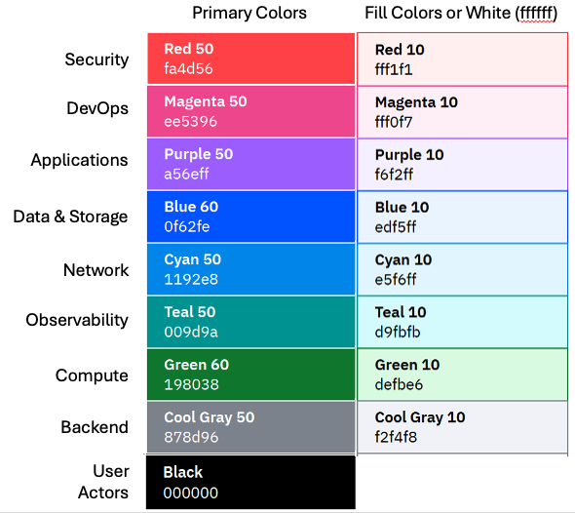
Color
The color palette shown here is a subset of the full IBM Design Language color palette.
Use primary colors for outlines, side bars, color blocks and connectors.
Use secondary colors only for fills.
Use alert colors only for badges.
For accessibility reasons, never rely on color alone to convey meaning.

Slide 4
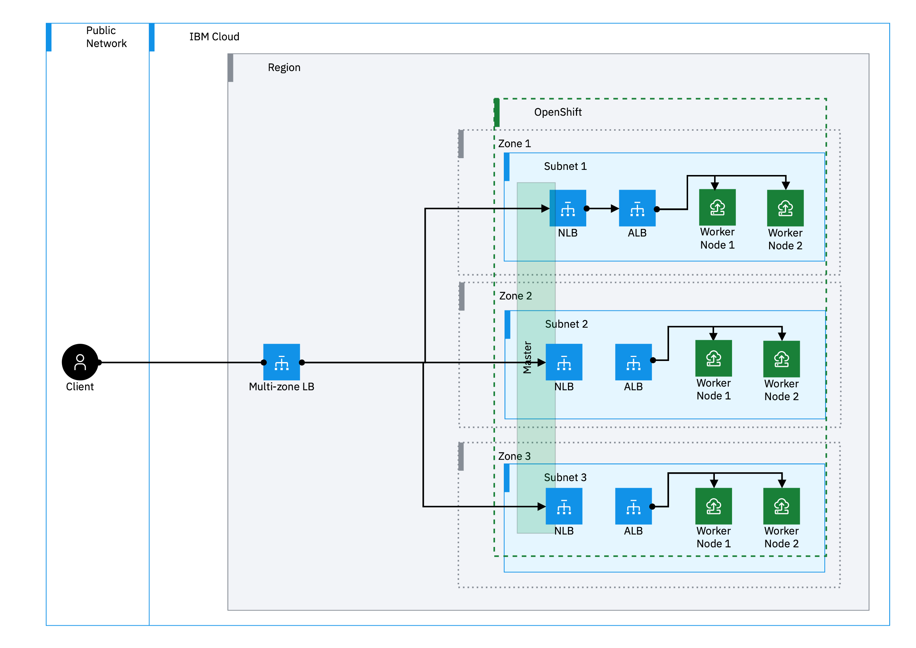
Examples
User
Data
Security
Network
Applications
Compute

Slide 5
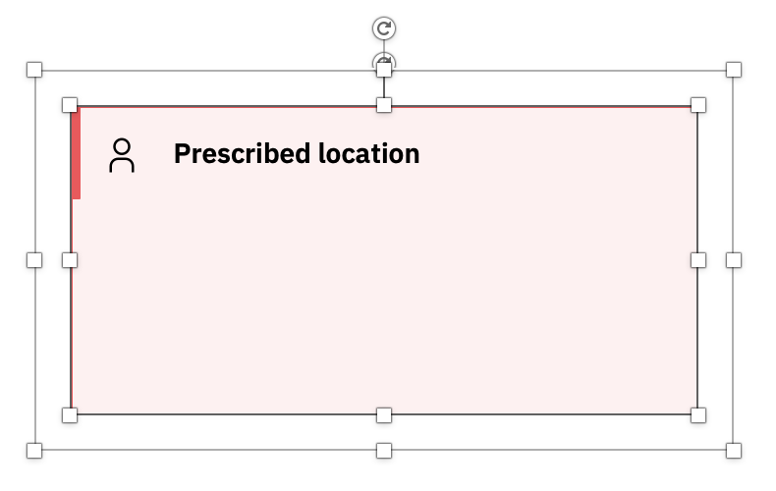
Scaling elements
Layering elements
1. Make sure the inside bounding box is highlighted by double clicking on the inside shape.
2. Drag the bottom left corner to scale to needed size.
When you nested elements, each inner element should have about 16px buffer on each side. Alternate white and light color fills for better readability.
Prescribed location
Prescribed location
Prescribed location
Prescribed location
Double click this line
Drag from this corner
IT architecture diagrams kit |

Slide 6
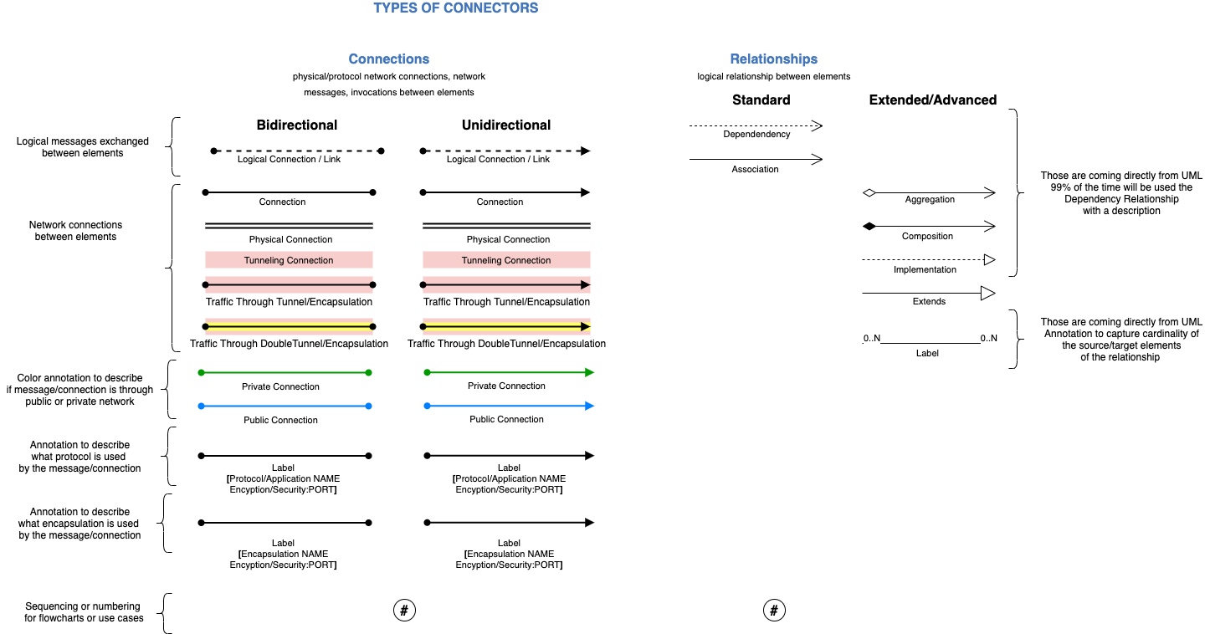
Connectors
IT architecture diagrams kit |

Slide 7
Cloud elements library
IT architecture diagrams kit |

Slide 8













Actors
User
Users
Group
Meeting
Administrator
Service
Desk User
User
Collaboration
Devices
Laptop
Mobile
Tablet
Location-
Country
Enterprise
Location

Slide 9








Applications
Application
Automation
Script
Call Application
CLI
Application
Web
Application
Mobile
Application
Virtual Application
API

Slide 10














AI
Governance
Lifecycle
Governance
Tracked
Launch AI
AI
AI
Group
IBM Watsonx
Governance
Machine
Learning
Model
Model
Tuned
Prompt
Session
Prompt
Template
Tuning
IBM Watsonx
IBM Watsonx Data
Serverless
Application

Slide 11























Storage & Data
Database
Data
Backup
Blob
Block
Storage
Block
Volume
File
Storage
File
System
Object
Storage
Object
Bucket
Archive
Data Stax
EnterpriseDB
ElasticDB
ETCD
MongoDB
PostreSQL
RabbitDB
Redis
Block Storage
Application
File Storage
Application
Object Storage
Application
Object Storage
Accessor
Object Storage
Slicestor

Slide 12











































Network
Subnet : ACL
CDN
DNS
Service
Floating IP
Hybrid
Networking
Internet
Message
Queue
Transit
Gateway
Overlay
Network
Load
Balancer
Pool
Unified
Communications
Wifi
Controller
VLAN
Internet
Services
LTE
Transmission
Wifi
Bridge
Voice
Router
Bridge
Router
VPC Load
Balancer
Classic
Load
Balancer
Global
Load
Balancer
Application
Load
Balancer
Network
Load
Balancer
Load
Balancer
Listener
Local
Load
Balancer
Wifi
Router
L2
Switch
L3
Switch
IBM
Subnet: ACL
Proxy
Server
Direct
Link
Load
Balancer
On VPC
VPC
Endpoint
DNS
Server
IBM
VLAN
Network
Interface
Gateway
Public
Gateway
API
Gateway
Mail
Gateway
Edge
Node
IBM
VPC
Public
Network

Slide 13











































Security
Document
Security
Document
protected
Signed document
Document
Protected
Document
unprotected
Fingerprint
recognition
ID management
Credentials
Network admin
control
Security
services
WiFi secure
WiFi
unsecure
VPN policy
Two-factor authentication
VPN
connection
Code signing
service
Policy
Encryption
Password
Locked
Subnet
ACL rules
IBM Cloud
Key Protect
Security
Gateway
Bastion Host
Hardware security module
SIM card
firewall
Session
border
controller
User access
gateway
Gateway
security
Intrusion Prevention
System
VPN
gateway
Data diode
PCN E Node
PCN P node
PCN Z node
Data
Diode
IBM VPC
For VPN
Security
Group
Rule
VPN
Gateway
Certificate
Secrets
Manager
Group
Security

Slide 14










Observability
Alerting
Auditing
Call
Manager
IT Service
Management
GUI
Management
Logging
Monitoring
Operational
Chat
Flow
Logs
GUI

Slide 15



























Compute & Containers
Image
Service
Chip
Chip
Virtual
Server
Physical
Server
Virtual
Desktop
OpenShift
Kubernetes
Kubernetes
Cluster
Instance Group
Virtual Server
Profile Bx
Virtual Server
Profile Cx
Virtual Server
Profile Mx
Satellite
Satellite
Config.
Satellite
Link
Satellite
Services
Virtual
Server
Classic
IBM Virtual
Server
IBM Bare
Metal
Dedicated
Host
Cloud
Registry
IBM Bare Metal
For VPC

Slide 16








IBM Cloud Paks
IBM Cloud Pak for Application
IBM Cloud Pak for Data
IBM Cloud Pak for Integration
IBM Cloud Pak for Multicloud
Management
IBM Cloud Pak for Network
Automation
IBM Cloud Pak for Security
IBM Cloud Pak for System
IBM Cloud Pak for Watson
AIOps

Slide 17
Create your own Icons
Application &
AI
Storage &
Data
DevOps
Management
Networking
Security
Link to IBM Design UI Icons:
https://www.ibm.com/design/language/iconography/ui-icons/library/

Slide 18













Groups
Cloud Services
IBM Core: Groups
IBM Cloud: Groups
Enterprise
Data Center
Cloud
IBM Core: Groups: Locations
Point of Presence
IBM Cloud: Groups: Locations
IBM Cloud
Availability zone
Region
Virtual Server
Physical Server
IBM Core: Groups: Compute
IBM Cloud: Groups: Compute
Instance group
IBM Virtual Server
Classic Infrastructure

Slide 19

















Groups
IBM Core: Groups: Containers
OpenShift
Public Network
VLAN
VPC
Internet
IBM Core: Groups: Network
Overlay Network
Subnet: ACL
IBM Cloud: Groups: Network
Internet services
VPC Endpoints
IBM Subnet: ACL
IBM Classic VLAN
IBM VPC
Authorization Boundary
IBM Core: Groups: Security
IBM Cloud: Zones: Security
Account group
Security group
Access group
Resource group

